Slide 1
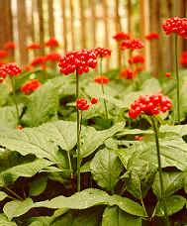
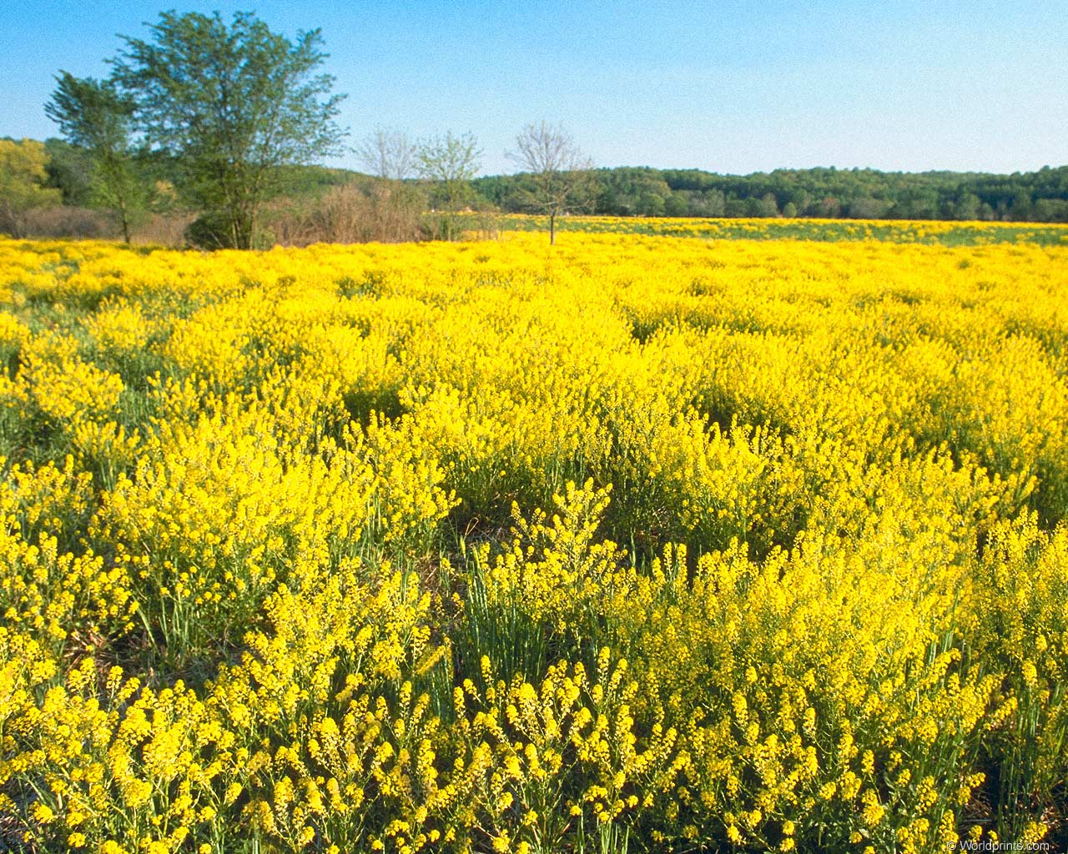
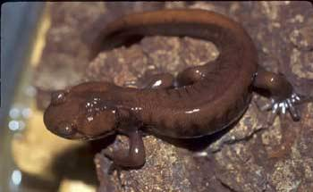
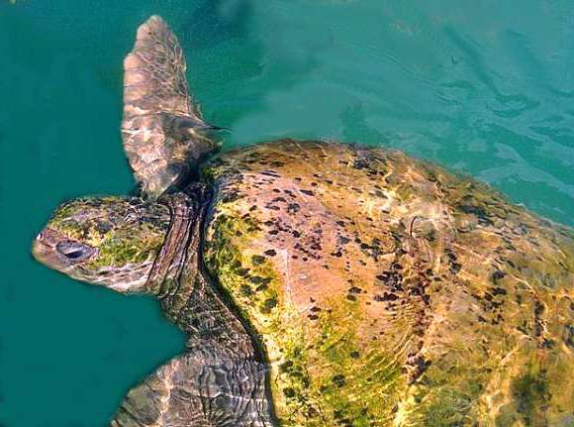
Structured Populations

Slide 2
Exponential Growth Model

Slide 3
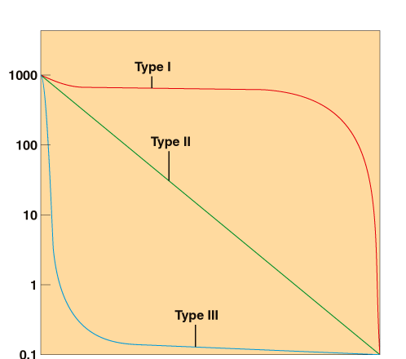
Birth and death rates depend on age
Number of survivors
(log scale)
Age

Slide 4
Survivorship based on multiple age classes (or size, stage) sampled from one time step to the next
Time t
Time t+1
Newborn
1-year old

Slide 5
Exponential growth model
N_{t} = 30 individuals
Age-structured model
N_{t} =
newborns
20
8
1-year olds
2
2-year olds

Slide 6
Exponential growth model
N_{t} = 30 individuals
Age-structured model
0
F₁
F₂
F₁
F₂
S₀
0
0
0
1
2
S₀
S₁
0
S₁
0

Slide 7
Exponential growth model
N_{t} = 30 individuals
Age-structured model
N_{t+1}=
0
F₁
F₂
20
S₀
0
0
8
0
S₁
0
2

Slide 8
Stage and Size predict survival and fecundity
Plants- seed, seedling, adult
Invertebrates- number of molts, larva-pupa-adult
Fish- size predicts sex and number of eggs produced
Amphibians- egg-tadpole-adult
Birds- egg-chick-adult
Mammals- newborn, juvenile, adult

Slide 9
Age vs. Stage or size Models
0
1
2
S
M
L
0
F₁
F₂
S
F_{M}
F_{L}
S₀
0
0
S
S
S
0
S₁
0
S
S
S

Slide 10
Applications of Matrix Models
1. Management of threatened species
Loggerhead Sea Turtle
Goal-increase population growth
2. Sustainable harvesting
Ginseng
Goal-harvest plants without driving the population extinct
3. Management of pests
Scotch Broom
Goal-reduce population growth

Slide 11
Loggerhead Sea Turtles:
A threatened species

Slide 12
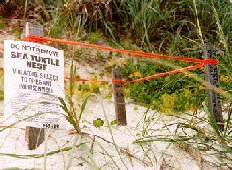
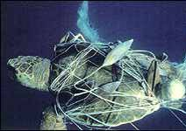
Two management scenarios
Protect eggs- Prevent human access
Protect adults- turtle excluder devices
Which one will best help increase the population growth rate?

Slide 13
Life cycle of Loggerhead Sea Turtles
0.70
0.66
0.68
0.81
0.68
0.05
0.02
Sub-
adult
0.06
egg
hatchling
juvenile
adult
4.7
61.9
Time t
e
h
j
s
a
e
0
0
0
4.7
61.9
h
0.68
0.70
0
0
0
j
0
0.05
0.66
0
0
Time t+1
s
0
0
0.02
0.68
0
a
0
0
0
0.06
0.81

Slide 14
0
0
0
4.7
61.9
100
N_{t+1}=
0.68
0.70
0
0
0
0
0
0.05
0.66
0
0
0
0
0
0.02
0.68
0
0
0
0
0
0.06
0.81
0

Slide 17
Life cycle of Loggerhead Sea Turtles
0.70
0.66
0.68
0.81
0.68
0.05
0.02
Sub-
adult
0.06
egg
hatchling
juvenile
adult
4.7
61.9
Time t
e
h
j
s
a
e
0
0
0
4.7
61.9
h
0.68
0.70
0
0
0
λ=0.96
j
0
0.05
0.66
0
0
Time t+1
s
0
0
0.02
0.68
0
a
0
0
0
0.06
0.81

Slide 18
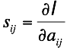
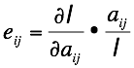
Perturbation Analyses
how a change in a matrix element affects λ
0.70
0.66
0.68
0.81
0.68
0.05
0.02
Sub-
adult
0.06
egg
hatchling
juvenile
adult
4.7
61.9

Slide 19
Turtle elasticity matrix
e
h
j
s
a
e
0
0
0
0.01
0.05
h
0.06
0.16
0
0
0
j
0
0.06
0.13
0
0
s
0
0
0.06
0.15
0
a
0
0
0
0.05
0.27
Deborah Crouse et al. 1987. A stage-based population model for loggerhead sea turtles and implications for conservation. Ecology 68:1412-1423.

Slide 20
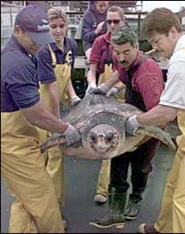
Shrimp Nets and Turtles
Every year, 12,000 sea turtles were killed by shrimp nets

Slide 21
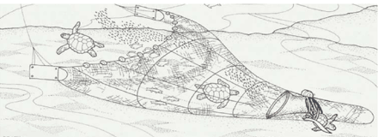
Turtle Excluder Device (TED)
If used properly, TED reduce sea turtle deaths by 97%
Notes:
http://www.youtube.com/watch?v=j9olIycYg0c

Slide 22
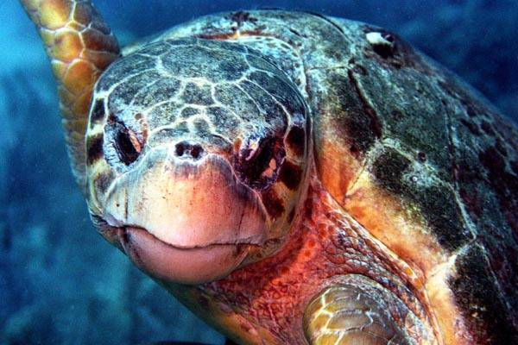
In 1987, the U.S. Congress passed Public Law 101-162
Required the permanent use of turtle excluder devices (TEDs) on shrimp trawlers operating anywhere in U.S. waters
250
200
150
# Adult Turtles
100
50
0
1985
1995
TED

Slide 23
Assumptions

Slide 24
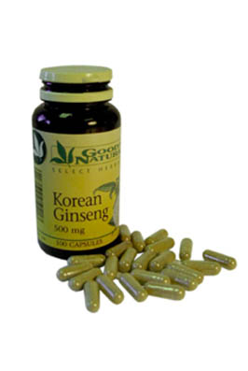
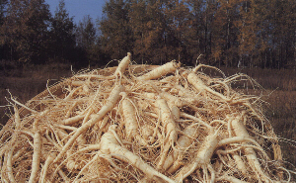
Ginseng: Can populations sustain human harvesting?
Used to treat depression, chronic diarrhea, digestive disorders, hair loss, headaches, hypertension or high blood pressure, impotence, insomnia, TMJ syndromes (jaw pain and clicking), nervous and anxiety disorders, obsessive compulsive behaviors, various skin conditions, and ulcers.

Slide 25
Life cycle of Ginseng
6.53
33.58
0.59
0.53
0.43
0.77
0.86
0.15
0.14
0.38
0.44
0.17
1
2
3
4
5
6
0.05
0.03
0.11
0.01
0.04
0.02
1
2
3
4
5
6
1
0
0
0
0.59
6.53
33.58
2
0.15
0
0
0
0
0
λ=1.06
3
0
0.14
0.53
0.05
0
0
4
0
0.01
0.38
0.43
0.03
0
5
0
0
0.04
0.44
0.77
0.11
Charron and Gagnon 1991
Journal of Ecology
6
0
0
0
0.02
0.17
0.86

Slide 26
Elasticity matrix for Ginseng
1
2
3
4
5
6
1
0
0
0
0.001
0.02
0.06
2
0.07
0
0
0
0
0
3
0
0.07
0.06
0.004
0
0
4
0
0.01
0.06
0.06
0.01
0
5
0
0
0.01
0.06
0.20
0.02
6
0
0
0
0.01
0.07
0.23
Ginseng populations can only sustain between 2-16% harvesting

Slide 27
Scotch Broom

Slide 28
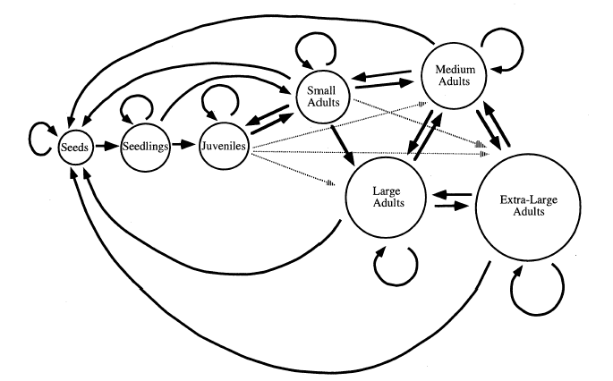
Life cycle graph
Parker 2000

Slide 29
Matrix
Seed
SL
Juv.
Sm
Med.
Lg
XL
Seed
0.60
0
9.6
97.5
422
861
2725
SL
0.01
0.23
0
0
0
0
0
Juv.
0
0.35
0.21
0.01
0
0
0
Sm
0
0.02
0.39
0.32
0.03
0
0
Med.
0
0
0.14
0.46
0.37
0.01
0.03
Lg
0
0
0.03
0.05
0.37
0.44
0.03
XL
0
0
0.01
0.01
0.11
0.49
0.85

Slide 30
Elasticity Matrix
Seed
SL
Juv.
Sm
Med.
Lg
XL
Seed
0.08
0
0
0.01
0.02
0.02
0.08
SL
0.14
0.02
0
0
0
0
0
Juv.
0
0.13
0.02
0
0
0
0
Sm
0
0.01
0.06
0.02
0
0
0
Med.
0
0
0.04
0.05
0.03
0
0
Lg
0
0
0.02
0.01
0.05
0.03
0
XL
0
0
0.01
0
0.02
0.05
0.09

Slide 31
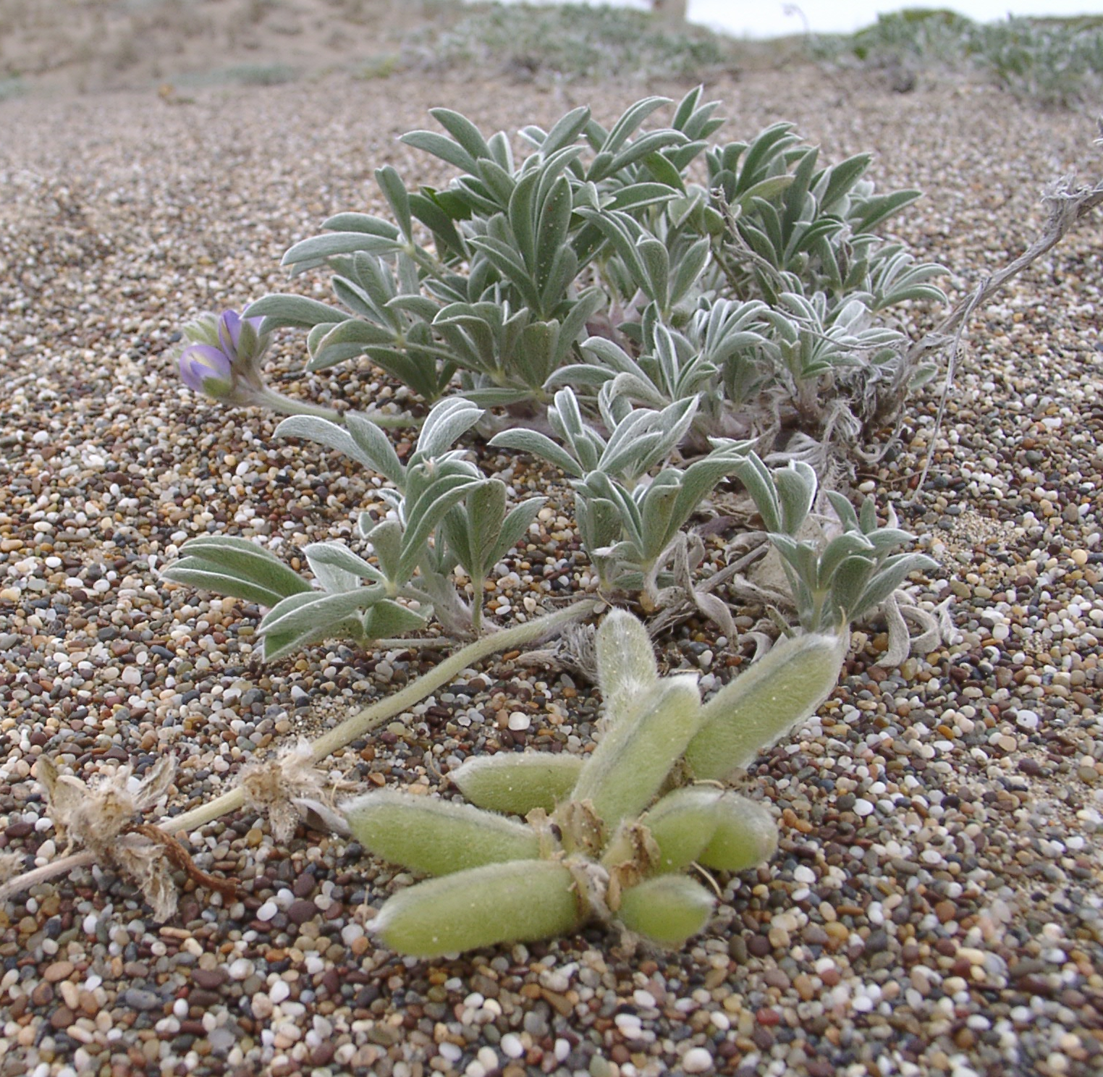
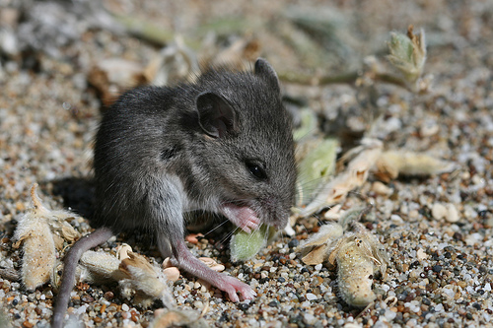
Computer Lab
Is predation by mice a significant threat to the endangered plant Lupinus tidestromii?

